Slide 1
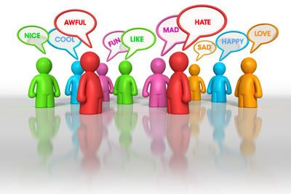
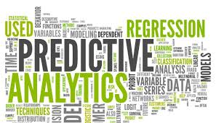

PREDICTIVE ANALYSIS OF AMAZON PRODUCTS
MAJOR PROJECT FINAL DEMO PRESENTATION ON
Project Convener: Project Guide:
Dr. B Sathish Babu Prof. K Bhargavi
Team Members:
Ashish Gupta(1SI13CS020)
Jagatjyoti G.Tuladhar(1SI13CS040)
Sachit Shrestha (1S13CS104)
Ujjen Man Bania(1SI13CS127)

Slide 2

Motivation and Relevance
Problem Statement
Objectives
Literature Survey
Software Design Methodology
Architecture
Data Flow Diagram
UML diagram
Algorithms
Interface Design
Tools and Technology
Coding and Testing Details
Result obtained
Conclusion

Slide 3
Motivation and Relevance
In the current scenario, we notice that customers who purchase the product from the E-commerce websites give their review about the product.
The customers who wishes to buy the product from E-commerce websites go through the reviews about that product.
But reading all the reviews may not be practically possible since it takes lot of time and may confuse the customer.
So, we propose a Predictive Analysis system which generates a rating of the product and gives useful insights to the customer in the form of charts and graphs.
Also, the vendor may want to know the future trend of the product . So, further we predict the future success and failure of the product.

Slide 4
Problem Statement
To provide decision making capability by generating most appropriate product rating based on the customer reviews and predicting the future success or failure of the product through various charts and graphs.

Slide 5
Objectives
To generate most appropriate product rating based on reviews.
To provide decision making capability for the customers regarding the product
To generate charts and graphs from the reviews of particular product.
Predict the future success or failure of the product using time series model.

Slide 6
Literature Survey
Sentiment Analysis and Opinion Mining
Authors: Liu Bing
Publication details: Synthesis Lectures on Human Language Technologies, May 2012,Vol .5,No. 1,Pages 1-67
Description:
Given a piece of written text, the problem is to categorize the text into one specific sentiment polarity, positive or negative (or neutral).
Based on the scope of the text, there are three levels of sentiment polarity categorization, namely the document level, the sentence level, and the entity and aspect level.

Slide 7
Mining and summarizing customer reviews
Authors: Hu M, Liu B
Publication Details: Proceedings of the tenth ACM SIGKDD international conference on Knowledge discovery and data mining. ACM, New York, NY, USA,August 22-25,2004,pages 168–17
Description:
A list of positive words and a list of negative words, respectively, based on customer reviews.
The positive list contains 2006 words and the negative list has 4783 words.
Sentiment categorization is essentially a classification problem, where features that contain opinions or sentiment information should be identified before the classification.

Slide 8
Predictive Modeling and Sentiment Analysis: Data Mining Approach
Author: Mr. Vijay D. Chougule , Mrs. Anis N. Mulla
Publication details: International Research Journal of Engineering and Technology(IRJET),Volume 3 Issue:8, Nov-2015,Pages 1-5
Description:
Data mining technology have widely been applied in various businesses and manufacturing companies. Sharing data has become a trend among business partnerships, as it is supposed to be a mutually beneficial way of increasing productivity .
Sentiment analysis and prediction modeling is use to determine future scope of product.
For sentiment analysis we take as an example online review of peoples towards the product they bought and services they received. Analysis of different online reviews on large scale will help to produce useful actionable knowledge.

Slide 9
Software Design Methodology Used
A software development methodology is a framework that is used to structure, plan and control the process of developing an information system.
The software development methodology followed here is the Spiral model.
Spiral model is a combination of iterative development process model and sequential linear development model (Waterfall model).
Spiral model is best suited for this project as the project is going to be released in an evolutionary manner.
Spiral model have 4 phases they are:
Requirement Gathering
Design
Construct or build
Risk Analysis

Slide 10
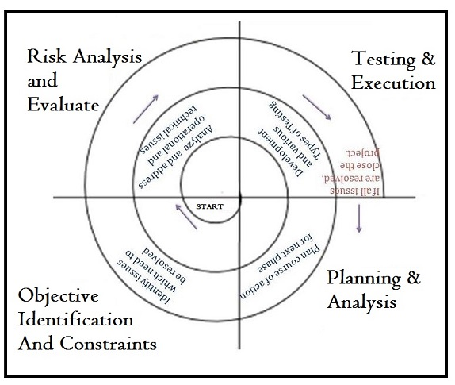
Fig: Spiral Model

Slide 11
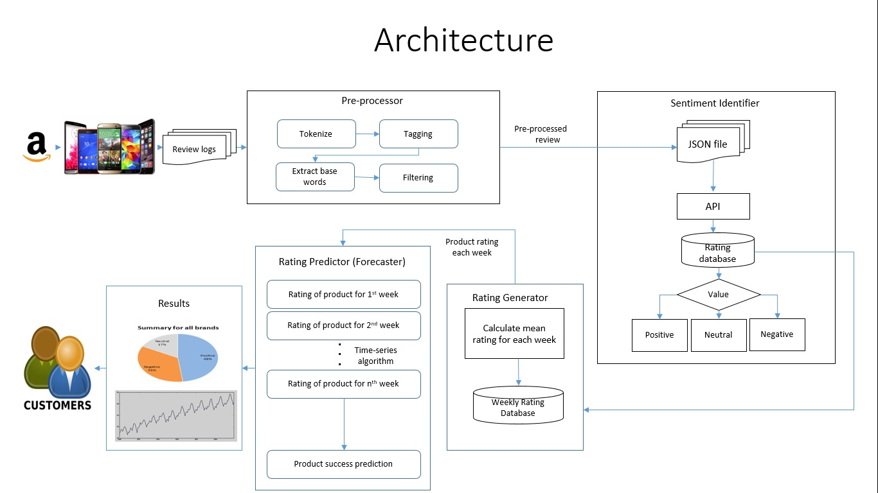
Fig: Architectural Design of Predictive Analysis for Amazon Product

Slide 12
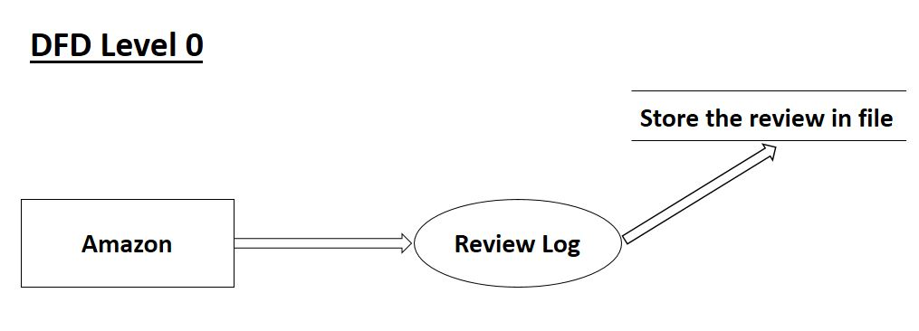
Data Flow Diagram

Slide 13
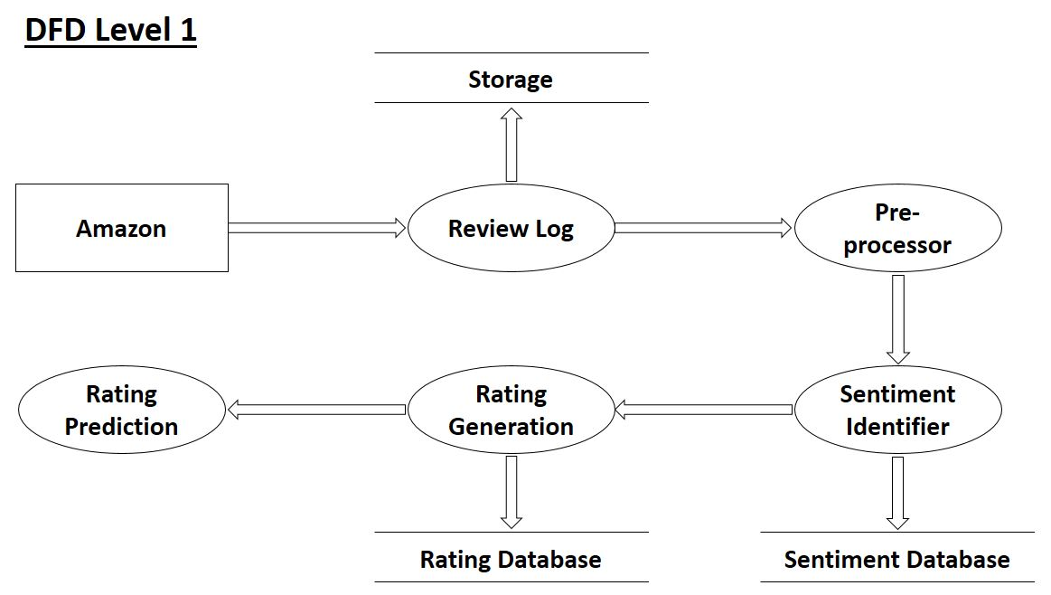

Slide 14
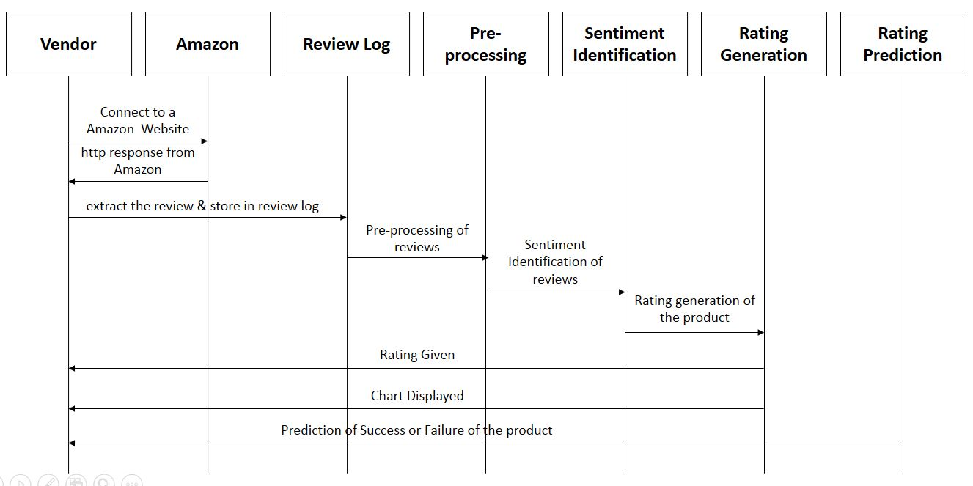
UML Sequence Diagram

Slide 15
Algorithm
Pre-processor
Step 1: Start
Step 2: For each review fetched from the review log file,
word_tokenize the review Wi
tag part-of-speech to each token, {(w1,POD),(w2,POS,(w3,POS),…}
extract base words using stemming process
filter the words based on part-of-speech and remove anomalies
Step 3: Store the result in a new JSON file
Step 4: End

Slide 16
Algorithm
Sentiment Identifier
Step 1: Start
Step 2: For each pre-processed record,
Generate the rating(Ri) using API
Store Ri and timestamp in the database
if Ri>5.5
positive = positive + 1
else if R1<5
negative = negative + 1
else
neutral = neutral +1
Step 3: End

Slide 17
Algorithm
Rating Generator
Step 1: Start
Step 2: Accept review_ratings (Ri) from database
Step 3: For each Ri,
Sum = ∑ review_ratings {R1,R2,R3,……}
Mean = Sum/Total no. of reviews for a week
Step 4: Weekly_Rating = Mean
Step 5: Store Weekly_Rating in a new table of the database
Step 6: End

Slide 18
Algorithm
Product Success/Failure Prediction
Step 1: Start
Step 2: For each week {w1,w2,w3…}
fti = wi – (wi-1)
Step 3: For each fti,
avg = ∑fti
Step 4: if avg>1 or wn>5 then
Success
else if avg<1 or wn<5 then
Failure
Step 5: End

Slide 19
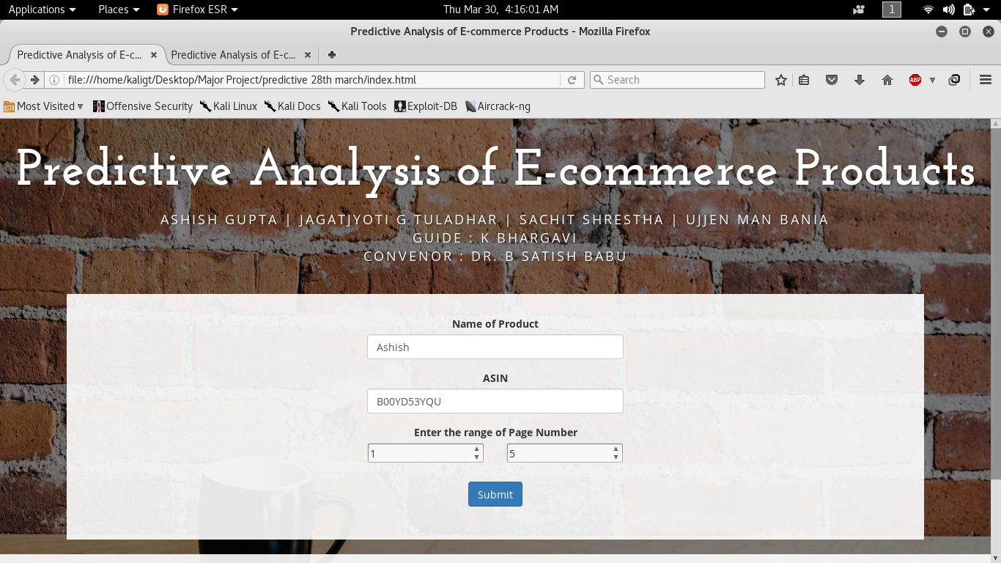
Interface Design

Slide 20

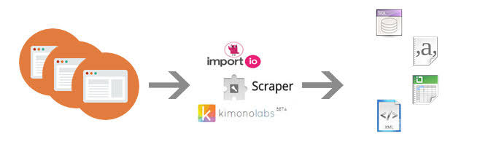
Tools and Technology
Python Programming Language :
It is an interpreted, object oriented and high-level programming language.
It provides constructs intended to enable writing clear programs on both small and large scale
It supports modules for creating GUIs, connecting to relational databases, manipulating regular expressions and generating various types of charts and graphs
Amazon Web Scraper :
Web scraping or web data extraction is the technology used for extracting data from websites.
This program access the Amazon website to extract reviews for a particular product along with the URL, review title and timestamp.

Slide 21




Tools and Technology (cont…)
Natural Language Toolkit (NLTK) : NLTK is a suite of libraries and programs for symbolic and statistical natural language processing(NLP) for the Python programming language.
Bootstrap : Bootstrap is a free and open-source front-end web framework for designing websites and web applications. It contains HTML and CSS based design templates along with JavaScript extensions.
Flask framework: Flask is a Python micro web framework built with a small core and easy to extend philosophy. It can be used to integrate Python script in web browser.
SQLite Database : SQLite is a relational database management system which has binding to many programming languages.

Slide 22
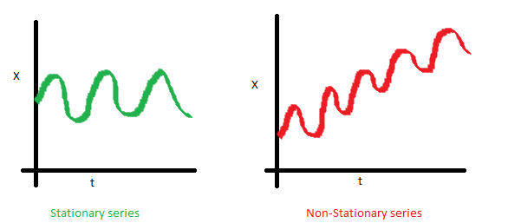
Time Series Modeling
It involves working on time (years, months, weeks) based data, to derive hidden insights to make informed decision making.
Unless the data series is stationary, you cannot build a time series model.
Stationary Series
There are three basic criterion for a series to be classified as stationary series :
1. The mean of the series should not be a function of time rather should be a constant.

Slide 23
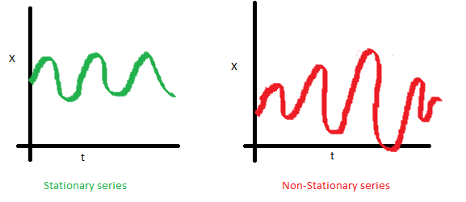
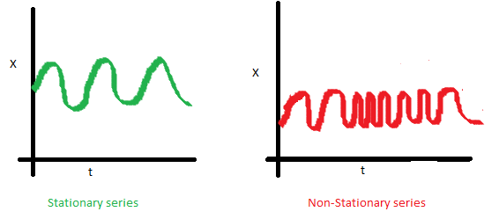
2. The variance of the series should not a be a function of time. The right hand graph has varying spread distribution.
3. The covariance of the i th term and the (i + m) th term should not be a function of time. In the following graph, you will notice the spread becomes closer as the time increases. Hence, the covariance is not constant with time for the ‘red series’.

Slide 24
ARMA Time Series Modeling
In ARMA model, AR stands for auto-regression and MA stands for moving average.
It is not applicable on non-stationary series.
Given a time series of data X_{t} , the ARMA model is a tool for understanding and, perhaps, predicting future values in this series.
The model consists of two parts, an autoregressive (AR) part and a moving average (MA) part.
The AR part involves regressing the variable on its own lagged (i.e. past) values.
The MA part involves modeling the error term as a linear combination of error terms occurring at various times in the past.
Once we have the final ARIMA model, we are now ready to make predictions on the future time points. We can also visualize the trends to cross validate if the model works fine.

Slide 25
Coding and Testing Details
The below listed modules are implemented successfully:
Web Scraper
Pre-processor
Sentiment Identifier
Rating Generator
Product success/failure predictor
These modules are integrated with the python code demonstrated in the next slide.
The modules which are to be integrated should be in the same folder.
A python module can use the functions or methods of other modules using ‘import’ keyword.

Slide 26
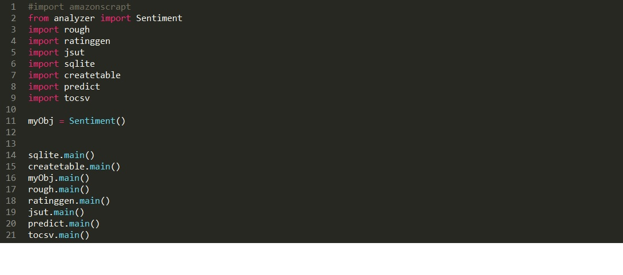
Code for integration of module

Slide 27
Test case : 01
Unit to test: The dataset format that the framework can handle.
Assumptions: Scrapped reviews are informative and every review is useful for analysis.
Test data: Real-time dataset on IPhone 5s from Amazon website.
Steps to be executed: Scrapping all the reviews and storing it in a file.
Expected result: Structured dataset in JSON format.
Actual result: Dataset in JSON format including URL, review, timestamp and title.
Pass/Fail: Pass
Comments: It is a slow process as scrapping each review takes time.

Slide 28
Test case : 02
Unit to test: The list of words generated by the pre-processor.
Assumptions : Each review contains words that are useful for sentiment analysis.
Test data: The dataset in JSON format.
Steps to be execute: Each review is tokenized, tagged with the parts of speech, baseword extraction and filtered.
Expected result: The preprocessed list contains only the words that are useful for sentiment analysis and stored in JSON format.
Actual result: The preprocessed list contains only the verbs, adverbs and adjectives that are necessary for sentiment analysis. The obtained lists are stored in a JSON file.
Pass/Fail: Pass
Comments: The review which do not contain any useful words result in an empty list.

Slide 29
Test case : 03
Unit to test: The classification of review.
Assumptions: Each review have its sentiment values which are used to classify the polarity
Test data: The rating of each review stored in the Rating_Database
Steps to be executed: Each rating is taken from the Rating_Database and compared with the predefined range to classify the review.
Expected result: Generation of pi-chart.
Actual result: Pi-chart is generated which represents the classification of all the reviews
Pass/Fail: Pass
Comments: The reviews classified as positive, negative and neutral.

Slide 30
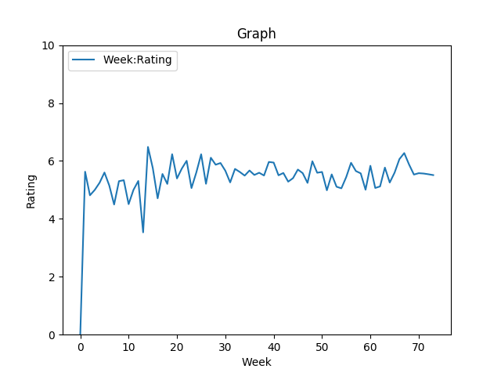
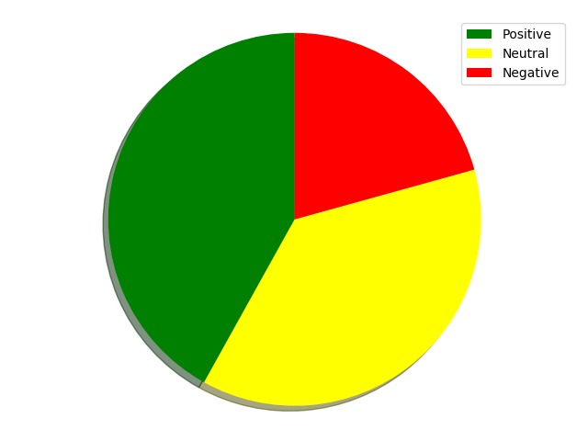
Result Obtained
Fig: Rating generation graph on a weekly basis
Fig: Pi-chart for Sentiment Classification

Slide 31
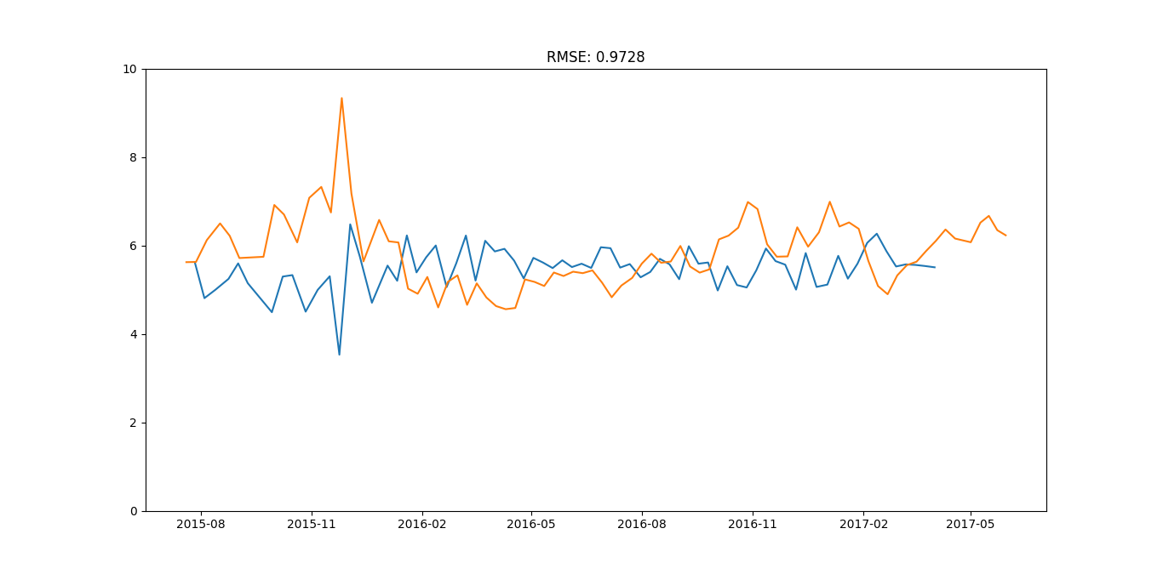
Time series model output

Slide 32
Conclusion
Sentiment analysis is an emerging field and we have made a small attempt to work on this field to extract knowledge from huge volume of data entered by the customers in the E-commerce websites.
In this project, the reviews are collected from the Amazon E-commerce website and stored in a file. Various sentiment analysis operations are performed on the file to classify the reviews as positive or negative and generate the rating on a weekly basis.
Finally, success or failure of the product is predicted.
This project is targeted for the customers who buy products online as well as the for the vendors who wish to see the future trend of their product.

Slide 33
THANK YOU

